Slide 1
F#, Immutability, and the MVU Pattern
Women Who Code
July 2021

Slide 2

Wallace Kelly
Ph.D., 1997
Corporate R&D / Contractor / Trainer / University / Startups
Seven patents
BASIC → FORTRAN → C → C++ → PHP → Java → C# → Python → F#

Slide 3
Outline
🗹 About the presenter
☐ Start downloads of the Docker images
☐ Evolution of Software Paradigms
☐ F# overview (w/ code demos)
☐ Immutability (w/ code demos)
☐ Model-View-Update (w/ code demos)
☐ Practice Exercises

Slide 4
Objectives
At the end of this workshop,...
☐ Motivated to adopt functional techniques.
☐ Describe the MVU pattern.
☐ Have experience editing F# code.

Slide 5
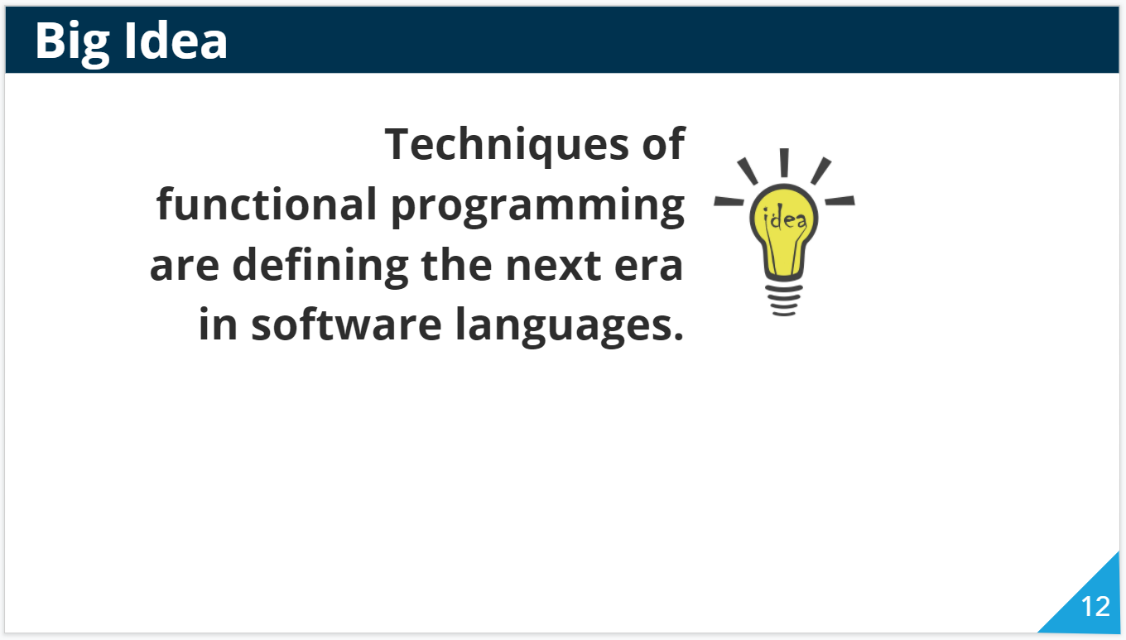
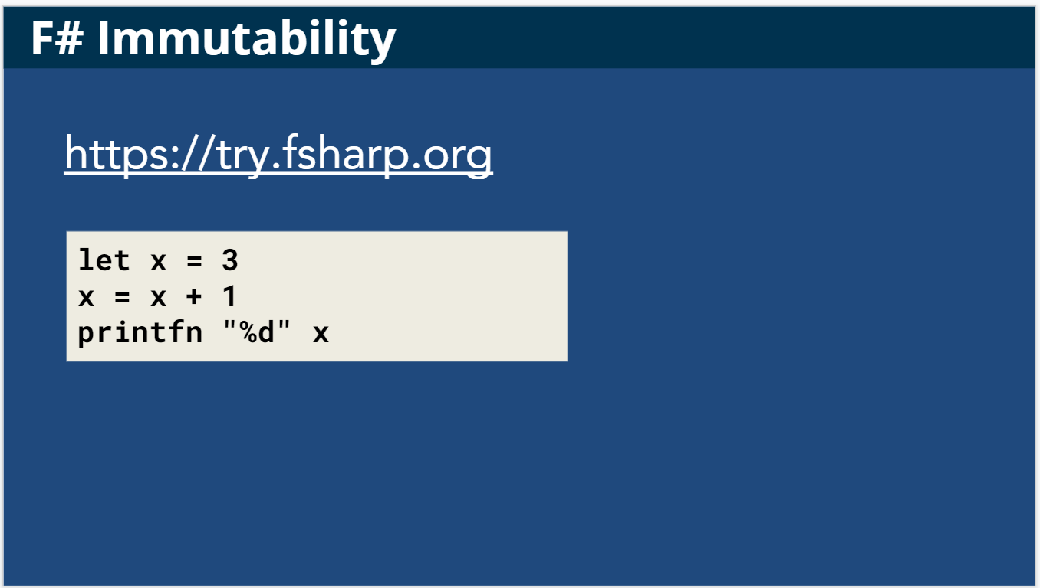
Two types of slides
Practice
Concepts

Slide 6
Prerequisite Software
Start both of these:
Visual Studio Code
Docker Desktop

Slide 7
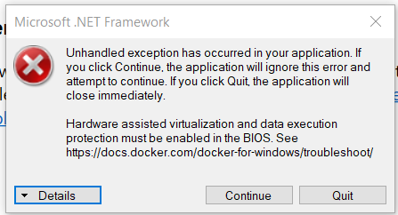
Windows Installation Issues
Docker Desktop requires:
Hardware virtualization enabled in BIOS
WSL2 is now a separate install

Slide 8
Install the required VS Code extension
In Visual Studio Code
Open the Extensions activity bar (Ctrl-Shift-X).
Search for “Remote - Containers”.
Press the Install button.
Or, on a command line
code --install-extension ms-vscode-remote.remote-containers

Slide 9
Start the download of Docker images
In Visual Studio Code
Open the Command Palette (Ctrl-Shift-P).
Type “Container Volume”.
Select “Clone Repository in Container Volume”.
Enter “WWCode-SV/fsharp-workshop”
Select the main branch.
Wait for it…
Click “Starting Dev Container (show log)”

Slide 10

Big Idea
Techniques of functional programming are defining the next era in software languages.

Slide 11
History of coding paradigms
Assembly
Procedural
Object Oriented
Managed Execution
Functional
CPU instruction set
Copy bytes
Perform operation
Jump to new location
Conditionals

Slide 12
History of coding paradigms
Assembly
Procedural
Object Oriented
Managed Execution
Functional
C / FORTRAN
Compiler
Interpreter
Variable
Data types
for loops
If / then / else

Slide 13
History of coding paradigms
Assembly
Procedural
Object Oriented
Managed Execution
Functional
C++ / Objective C
Classes
Objects
Encapsulation
Inheritance
Polymorphism
Interfaces
Templates

Slide 14
History of coding paradigms
Assembly
Procedural
Object Oriented
Managed Execution
Functional
Java / .NET
Bytecode / IL
Garbage collection
Bounds checking
Reflection
JIT compilation
Generics

Slide 15
History of coding paradigms
Assembly
Procedural
Object Oriented
Managed Execution
Functional
Scala / F#
Immutability
Expressions
Pattern matching
Composition
Currying

Slide 16
Emphasis of coding paradigms
Functional
Transform state with a series of functions.
Managed Execution
Run within a virtual machine.
Object Oriented
Model as objects with properties and methods.
Procedural
A series of instructions, but at a higher-level of abstraction.
Assembly
Interact with the CPU, RAM, and other devices.

Slide 17
Why the shift?
Functional
Improve our ability to reason about correctness.
Managed Execution
Provide helpful, cross-platform, runtime services.
Object Oriented
Organize lots of code into smaller, reusable components.
Procedural
Abstract away the details of the hardware.
Assembly
Interact with the CPU, RAM, and other devices.

Slide 18
Big Idea
Techniques of functional programming are defining the next era in software languages.
Why? Easier to reason about correctness.

Slide 19

F#
One of the new languages designed around the functional style.
For .NET / .NET Core
Functional-first
Cross-platform
General-purpose
Open source

Slide 20
Immutability
What? Once data is initialized, it cannot be modified.
What?! Make a copy of the data, with changes applied.

Slide 21
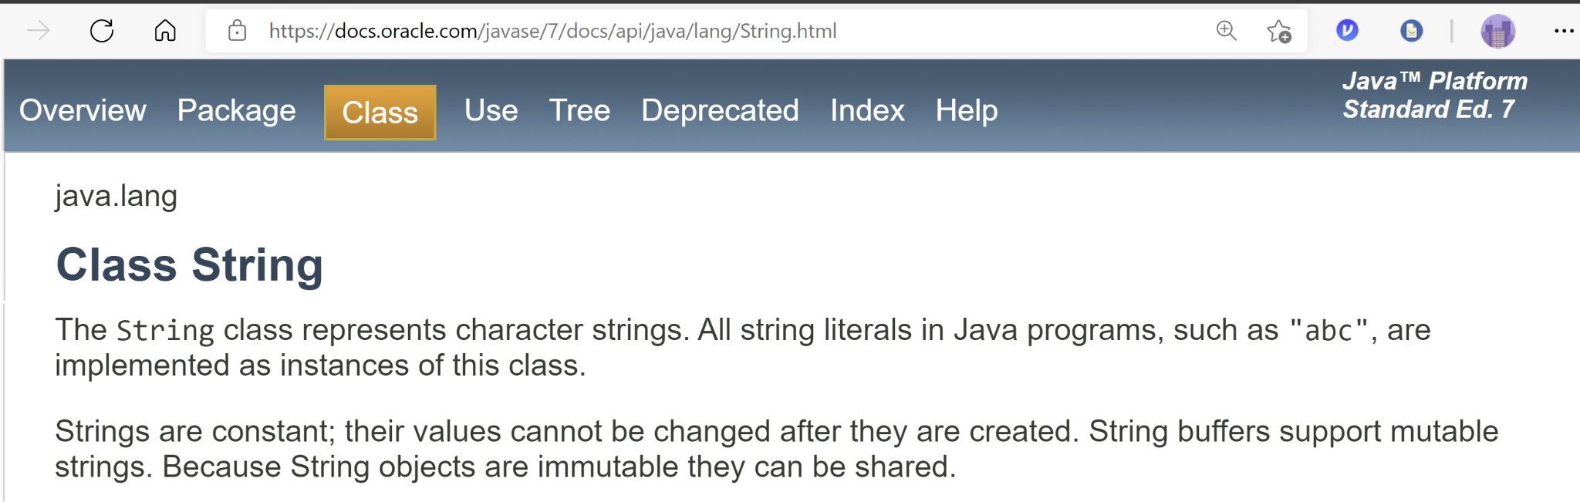
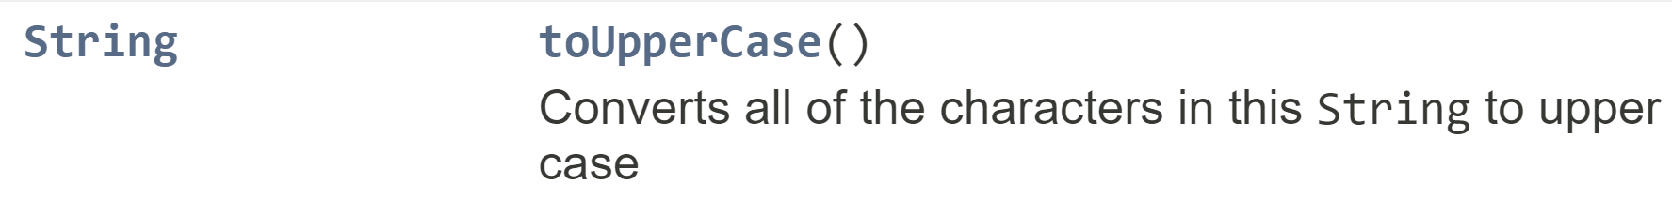
Familiar Example of Immutability

Slide 22
F# Immutability
https://try.fsharp.org
let x = 3
x = x + 1
printfn "%d" x

Slide 23
F# Records
F# records combine multiple values.
// F# record definition
type Workshop = {
Name: string
Attendees: int
}
// F# record instance
let workshop = {
Name = "F# and Immutability"
Attendees = 10
}
printfn "%A" workshop

Slide 24
F# Records
F# record instances can be defined:
On multiple lines
On the same line
// F# record instance
let workshop = {
Name = "F# and Immutability"
Attendees = 10
}
// F# record instance
let workshop = { Name = "F# and Immutability"; Attendees = 10 }

Slide 25

F# Records
F# records combine multiple values.
F# records are immutable.
workshop.Attendees = 13
workshop = {
Name = "F# and Immutability"
Attendees = 13
}

Slide 26
Practice summary
The let keyword instantiates a value
F# records combine multiple values.
F# values are immutable by default
let x = 3
// F# record definition
type Workshop = {
Name: string
Attendees: int
}
// F# record instance
let workshop = {
Name = "F# and Immutability"
Attendees = 10
}

Slide 27
Immutability and Functions
workshop_{i}
addRegistration
Workshop → Workshop
not the same instance
workshop_{i+1}

Slide 28
F# Records
F# records combine multiple values.
F# records are immutable.
let addRegistration (w: Workshop) = // Workshop -> Workshop
{
Name = w.Name
Attendees = w.Attendees + 1
}
let workshop2 = addRegistration workshop

Slide 29
Immutability and Functions
participants workshop_{i}
addRegistrations
int → Workshop → Workshop
workshop_{i+1}

Slide 30
F# Records
F# records combine multiple values.
F# records are immutable.
let addRegistrations (p: int) (w: Workshop) = // int -> Workshop -> Workshop
{
Name = w.Name
Attendees = w.Attendees + p
}
let workshop2 = addRegistrations 5 workshop

Slide 31
Function Pipelines
workshop_{i}
addRegistration
Workshop → Workshop
persistToDatabase
DbAccess → Workshop → Workshop
sendEmailUpdate
SmtpClient → Workshop → Workshop
workshop_{i+1}

Slide 32
F# Pipe Operator
F# has an operator for piping the output of one function into another.
let nextWorkshop =
prevWorkshop
|> addRegistration
|> persistToDatabase db
|> sendEmailUpdate smtp
result
|> Seq.map toDateRanges
|> Seq.toList
|> function
| [] -> State.Always
| [ d ] -> State.Sometimes(d)
| _ -> failwith "Duplicate keys!”
|> Concurrency.version nextVersion

Slide 33
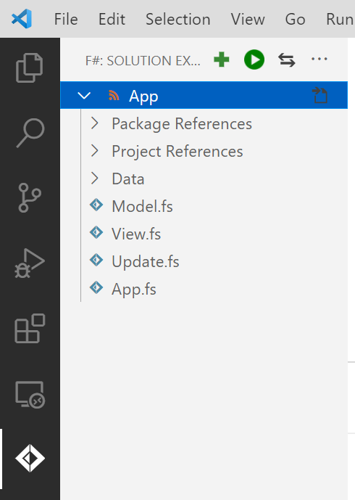
Confirm the setup is complete
Look for the Ionide extension.
F#

Slide 34
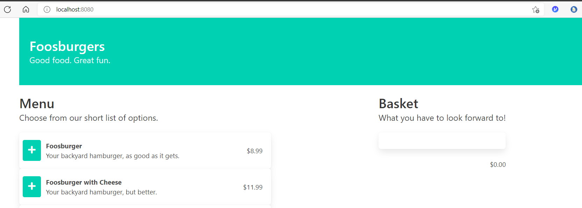
Confirm the website is running
Open http://localhost:8080

Slide 35
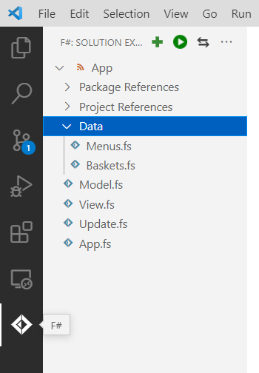
Add a record to the practice exercise
In Menu.fs:
Add an F# record instance to the list of sample menu items.

Slide 36
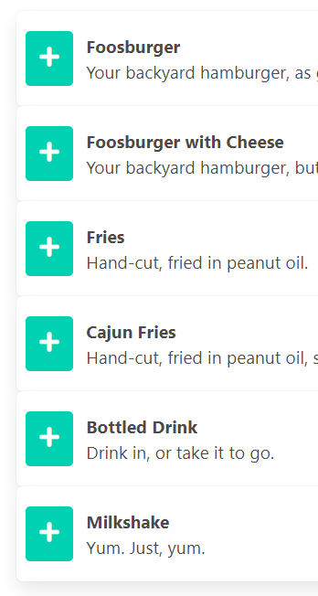
Add a record to the practice exercise
In Menu.fs:
Add an F# record instance to the list of sample menu items.

Slide 37
Practice summary
Edit existing F# code.
Add an F# record to a list of values.
{ MenuItem.Id = 6
Name = "Milkshake"
Description = "Yum. Just, yum."
Price = 5.99M }

Slide 38
F# Lists
Values (including records) can be grouped into lists.
let workshops = [
{ Name="Assembly for the dev"; Attendees=0 }
{ Name="Device driver coding"; Attendees=2 }
{ Name="Intro to OO Programming"; Attendees=5 }
{ Name="Java for JavaScript devs"; Attendees=10 }
{ Name="F# and Immutability"; Attendees=93 }
]

Slide 39
F# Lists
F# lists are immutable too!
let newWorkshop = {
Name="F# and List Processing"
Attendees=93
}
// prepend an item
let workshops2 = newWorkshop :: workshops
// append an item
let workshops3 = workshops @ [ newWorkshop ]

Slide 40
F# Lists
F# lists are immutable.
F# lists can be used in a pipeline.
workshops
|> List.sortByDescending (fun w -> w.Attendees)
|> List.take 3
|> List.map (fun w -> w.Name)
|> List.iter (printfn "%s")

Slide 41
F# Lambda Expressions
workshops
|> List.sortByDescending (fun w -> w.Attendees)
|> List.take 3
|> List.map (fun w -> w.Name)
|> List.iter (printfn "%s")
// Workshop -> int
fun w -> w.Attendees
“lambda expression”
“arrow function”
“anonymous function”

Slide 42
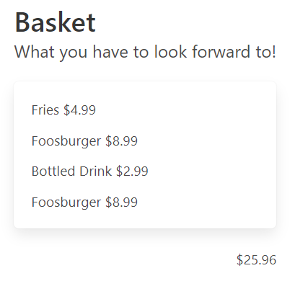
Notice the order of the basket items

Slide 43
Sort the items in the basket
In Baskets.fs:
Find the add(...) function.
Sort the items in the nextBasket:
Items = prevBasket.Items
|> List.append [ newBasketItem ]
|> List.sortBy(fun i -> i.MenuItem.Id)

Slide 44
Practice summary
Add to an existing pipeline of functions.
Use a “lambda expression.”
Items = prevBasket.Items
|> List.append [ newBasketItem ]
|> List.sortBy(fun i -> i.MenuItem.Id)

Slide 45
Outline
🗹 About the presenter
🗹 Start downloads of the Docker images
🗹 Evolution of Software Paradigms
🗹 F# overview (w/ code demos)
🗹 Immutability (w/ code demos)
☐ Model-View-Update (w/ code demos)
☐ Practice Exercises

Slide 46
Model View Update
Model: state of the component
View: render a given state
Update: new copy of the state after event
Advantages
Compatible with immutability.
Works nicely with React.

Slide 47
Model View Update
View
render
interaction
Model
Dispatch
new model
messages
Update

Slide 48
Model View Update - Elmish
render: State → Dispatcher → View
View
render
interaction
Model
Dispatch
init: unit → State
messages
new model
Update
update: Message → State → State

Slide 49
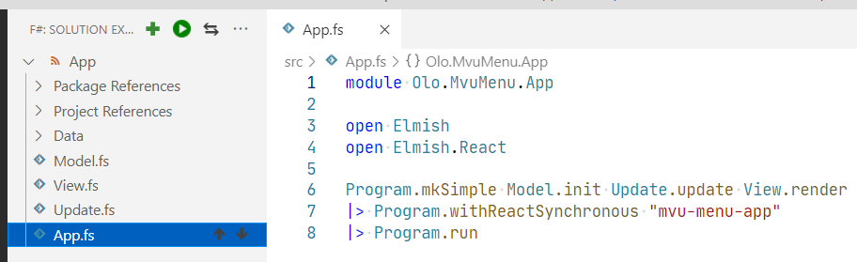
Explore the Practice Exercise
Do you see MVU?
What are signatures of the Elmish functions?

Slide 50
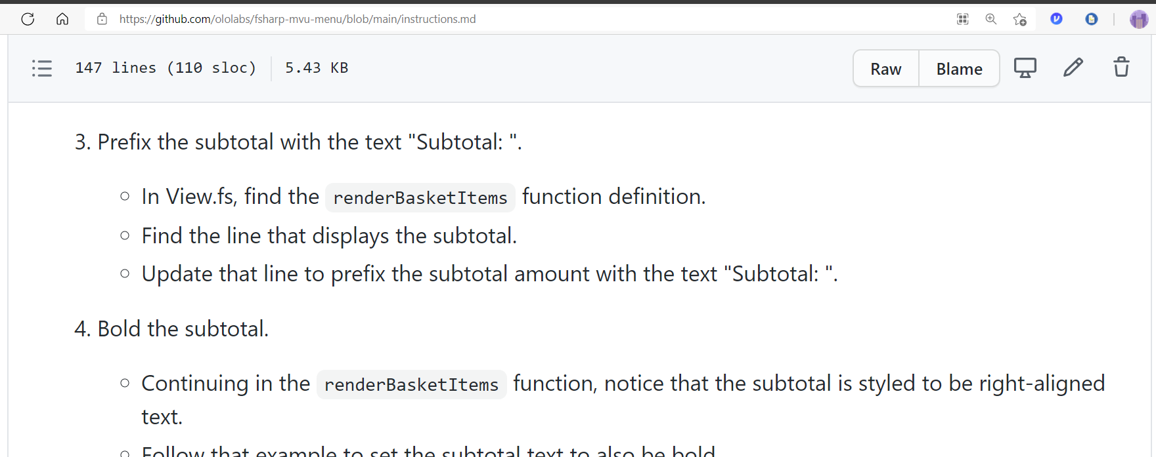
Complete Practice Exercise
https://github.com/WWCode-SV/fsharp-workshop/ instructions.md

Slide 51
Cleanup
In Visual Studio Code
Select File → Exit
In Docker Desktop
Select the Containers / Apps tab
Delete (trash can) the container.
Select the Images tab.
Remove the vsc-fsharp… image (and others).

Slide 52
Objectives
At the end of this workshop,...
🗹 Motivated to adopt functional techniques.
🗹 Describe the MVU pattern.
🗹 Have experience editing F# code.

Slide 53
Wallace Kelly
wallace.kelly@olo.com

